Slide 1


Finding Robust Bell Inequalities
for Quantum Many-Body Systems
Part I: arXiv:2511.07523 · Part II: arXiv:2607.08462
Jin-Fu Chen | CFT PAN Seminar, Warsaw | 30 October 2026
With Mengyao Hu and Jordi Tura
Applied Quantum Algorithms

Slide 2












Bell tests have gone many-body
loophole-free Bell tests
Hensen, Giustina, Shalm et al. (2015)
Bose–Einstein condensate
Schmied et al., Science 352, 441 (2016)
superconducting qubits
Wang et al., PRX 15, 021024 (2025)
spin-squeezed atomic ensemble
Engelsen et al., PRL 118, 140401 (2017)
Two parties: every correlator is measured. Many parties: only collective or few-body quantities.
Which Bell inequality should they test, and how much noise can it survive?

Slide 3



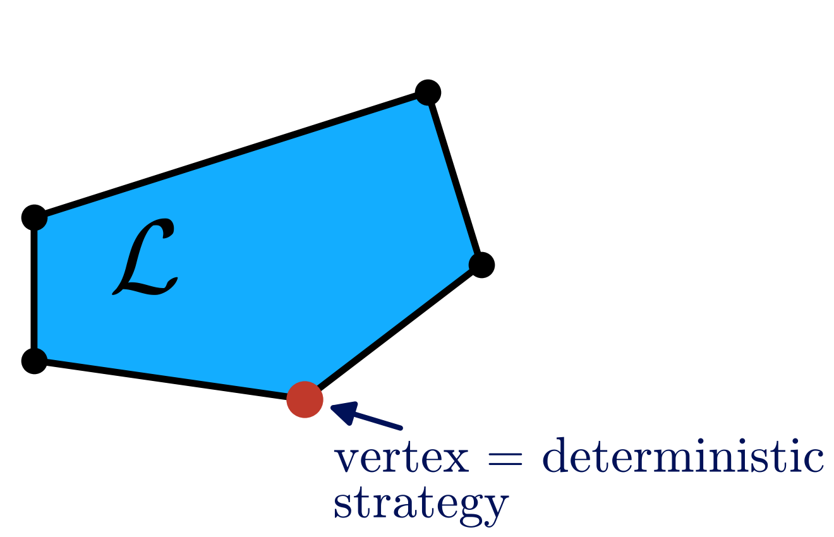




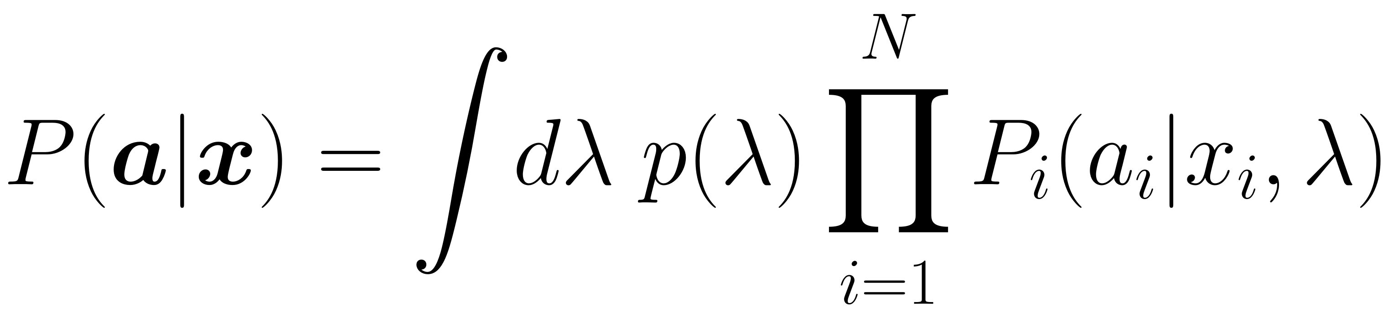
A Bell experiment
Alice
Bob
Charlie
…
Classical
source
local hidden-variable model

Slide 4
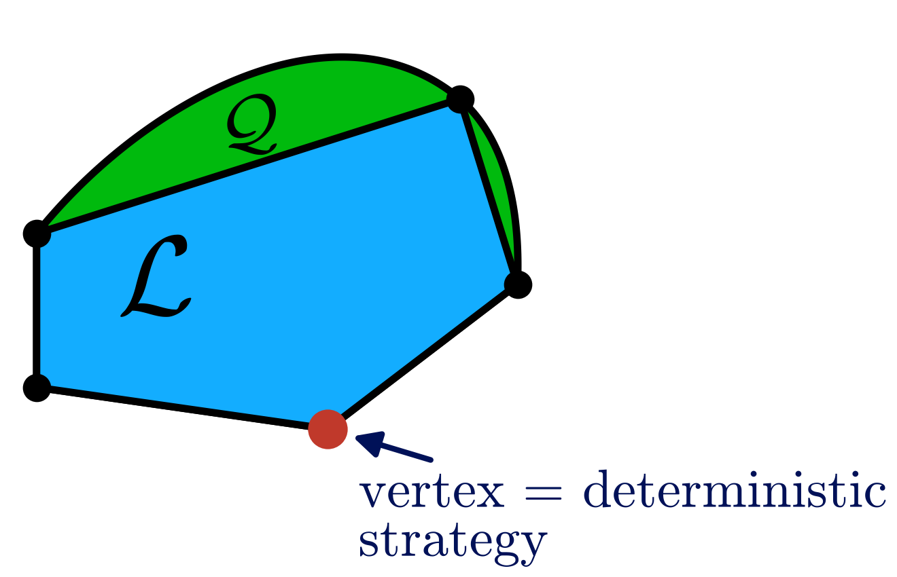
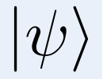
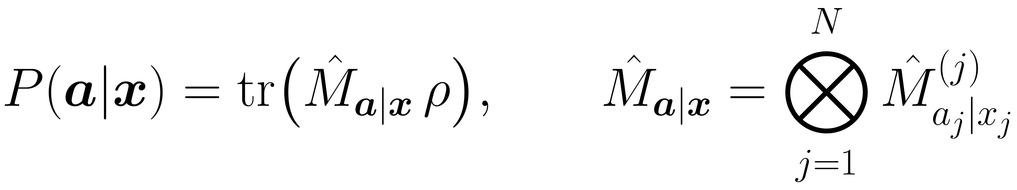
Quantum correlations
Alice
Bob
Charlie
…
Quantum
source
quantum model

Slide 5
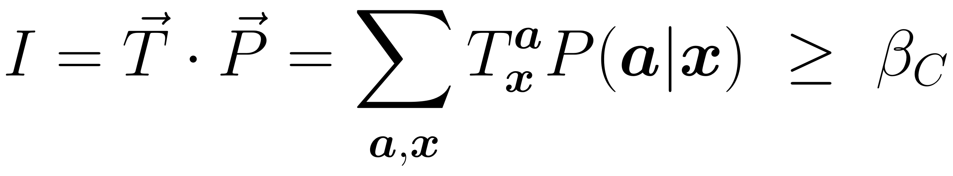
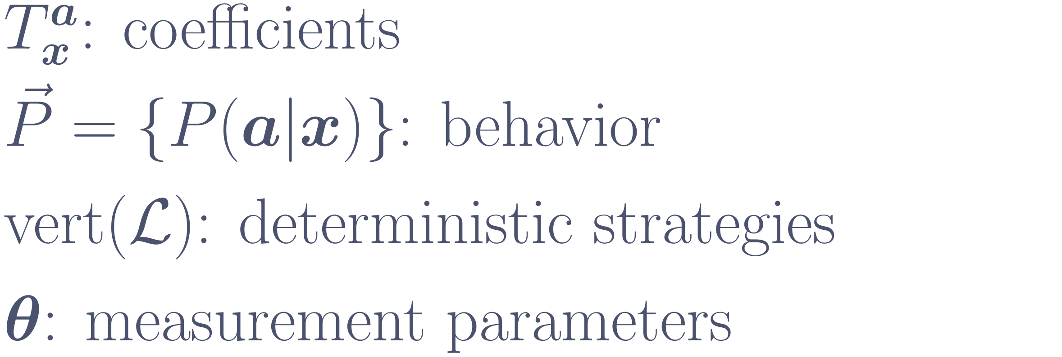
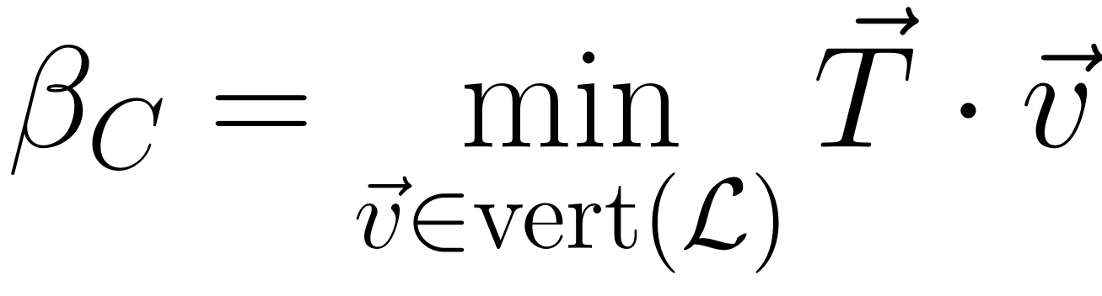
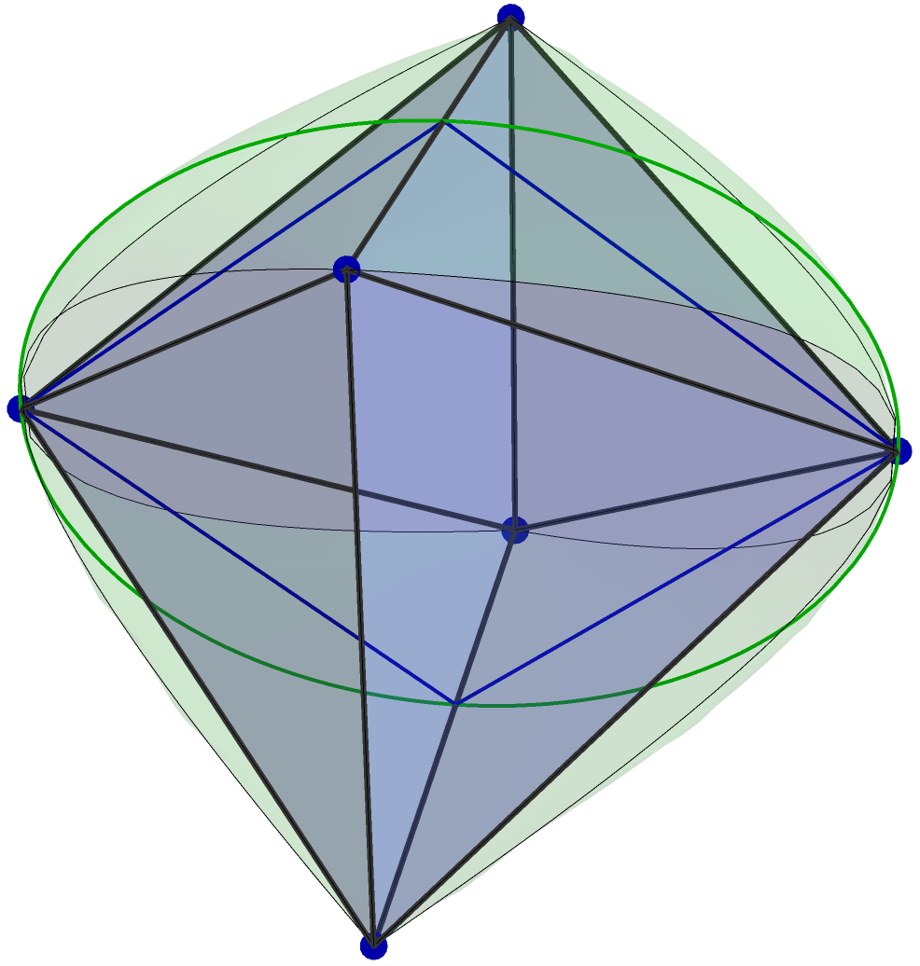
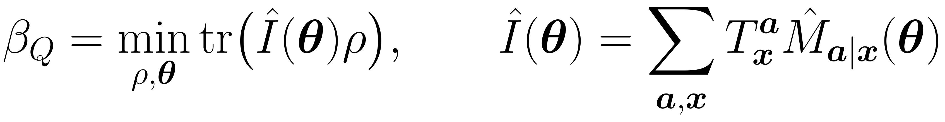
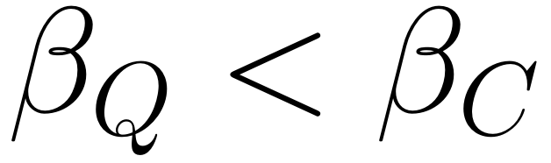
Bell inequalities and facets
Bell inequality
classical bound
quantum value
violation
tight
Facets: the natural candidates for good Bell inequalities.

Slide 6
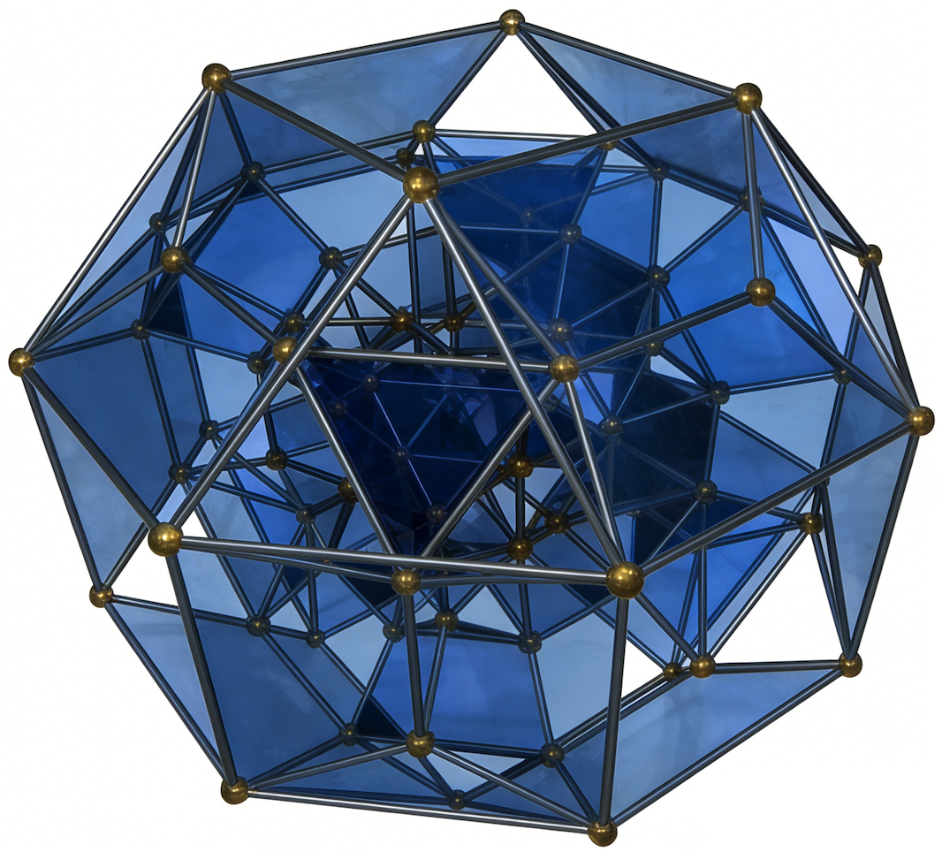
Why many-body Bell inequalities?
Certify
genuine multipartite entanglement, device-independently
Benchmark
quantum processors in the many-body regime
Obstacle
facet enumeration is intractable for many parties
Goal: search robust many-body Bell inequalities

Slide 7
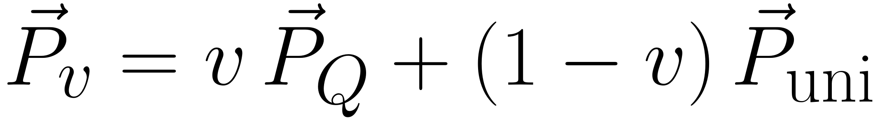
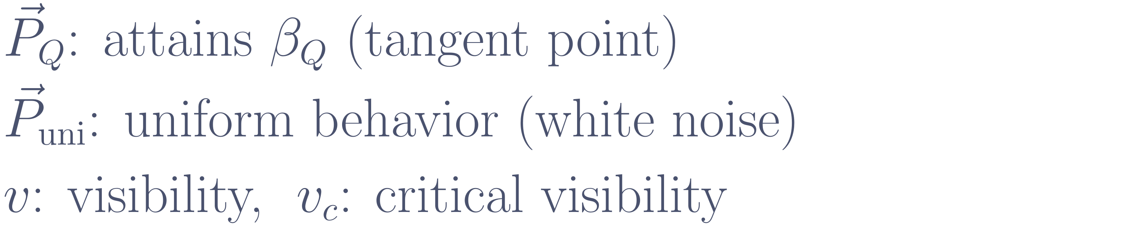
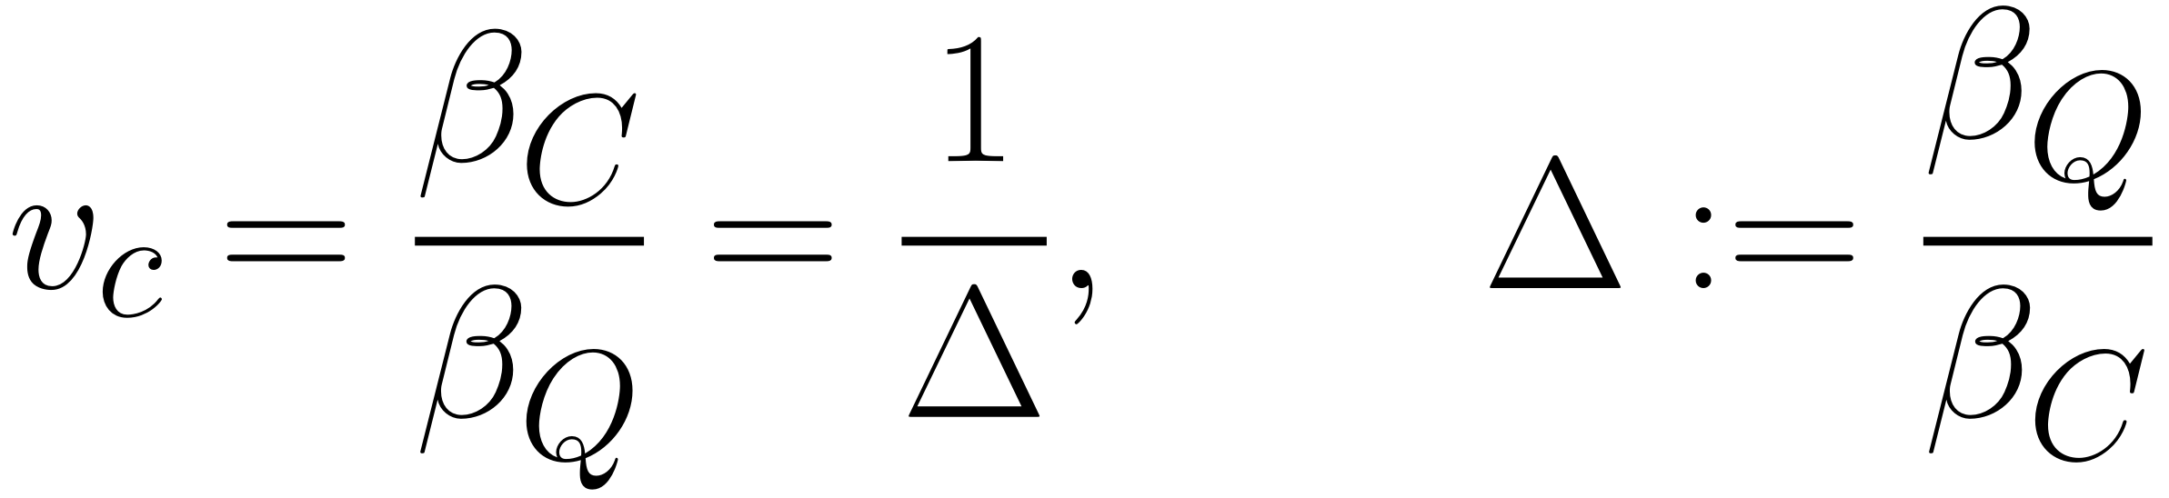
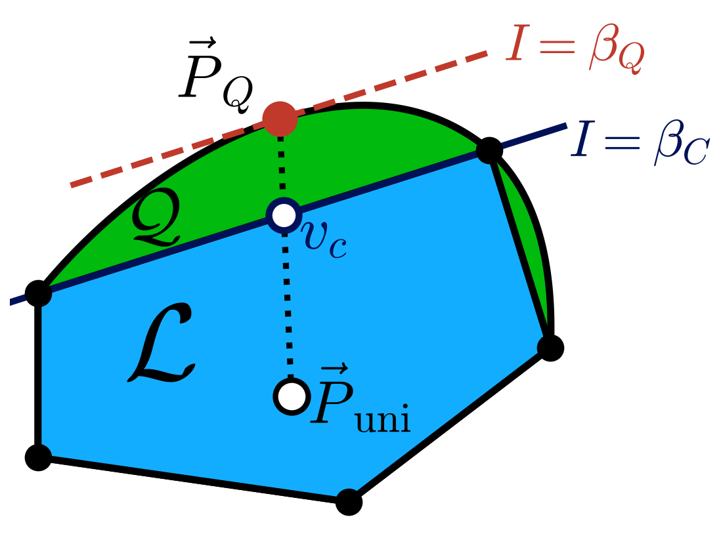
Robustness to white noise
critical visibility: noise budget
invariant under rescaling of the inequality

Slide 8
Outline
Background: Bell inequalities, facets, robustness
I
Gradient optimization of Bell inequalities
what we optimize → geometric picture → Theorem 1 → gradient and constraints → CHSH
II
Permutation-invariant Bell inequalities
collective correlators → facet families → thermodynamic limit → optimized inequalities
Summary and outlook

Slide 9
Part I
Gradient optimization of Bell inequalities
J.-F. Chen, M. Hu, J. Tura, arXiv:2511.07523

Slide 10
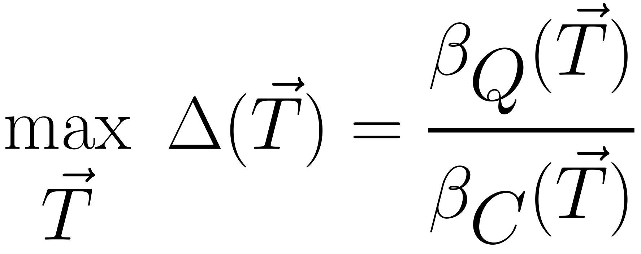
What we optimize
I · Gradient method
variables
classical bound
quantum value
gauge

Slide 11
The search, geometrically
I · Gradient method
1
Trial inequality
Shift to its classical bound

Slide 12
The search, geometrically
I · Gradient method
2
Supporting hyperplane
Touches the local polytope

Slide 13
The search, geometrically
I · Gradient method
3
Rotate the hyperplane
Lower the quantum value;
contact points stay fixed

Slide 14
The search, geometrically
I · Gradient method
4
New contact points
Added as constraints

Slide 15
The search, geometrically
I · Gradient method
5
Facet reached
No facet enumeration needed

Slide 16
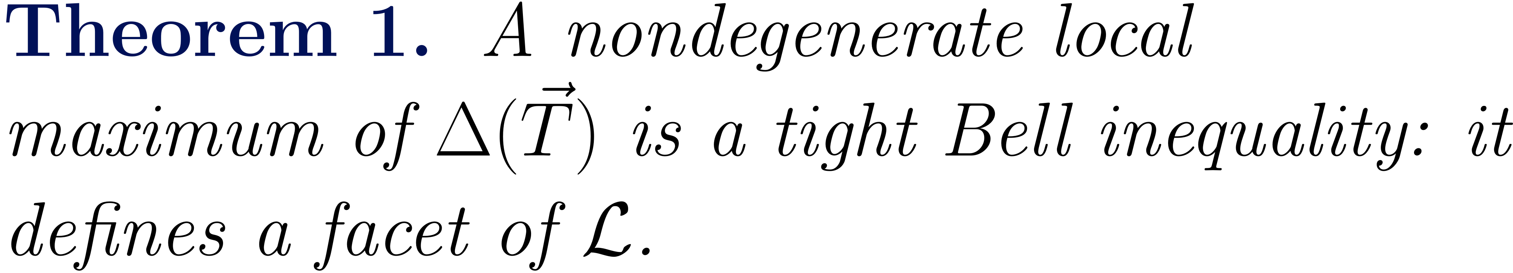
Theorem 1: robust local optima are facets
I · Gradient method
nondegenerate: ratio not flat along contact-preserving directions
robust and tight coincide at local optima
search among facets, without listing them
degenerate maxima: move to a facet without loss
holds for a fixed quantum ansatz (e.g. qubits)

Slide 17
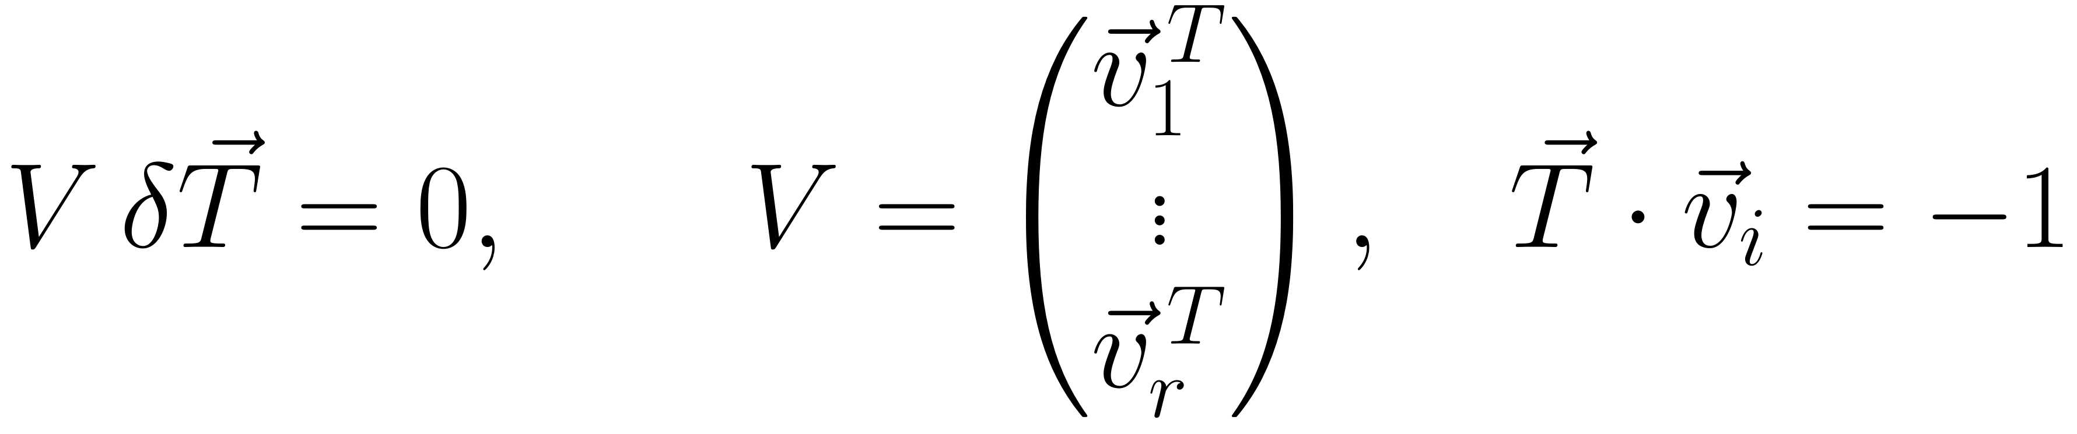

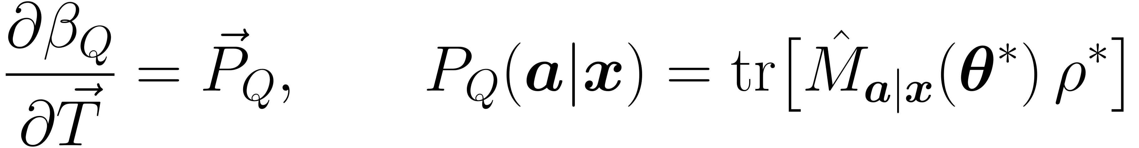
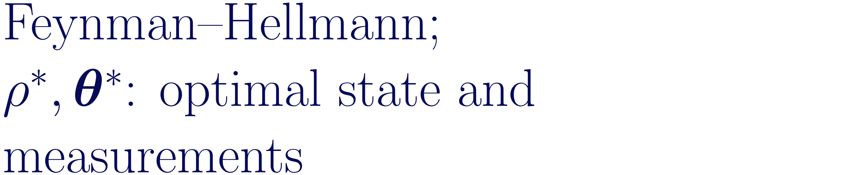
Gradient optimization: the ingredients
I · Gradient method
1
Normalize
2
Classical vertices: constraints
3
Quantum value: gradient

Slide 18
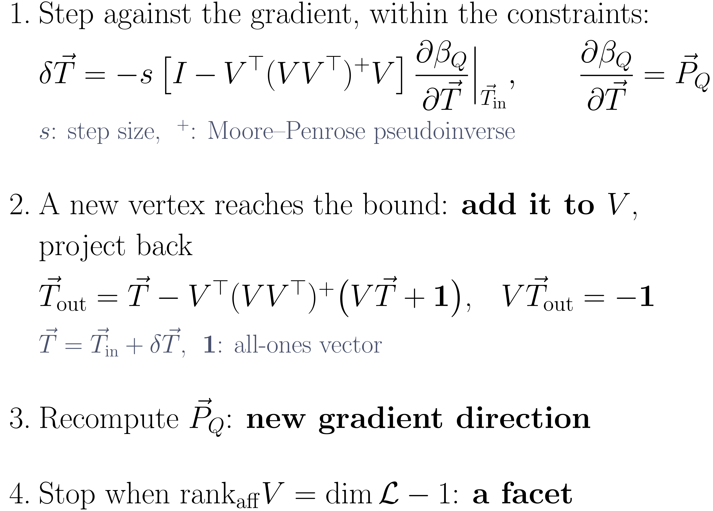
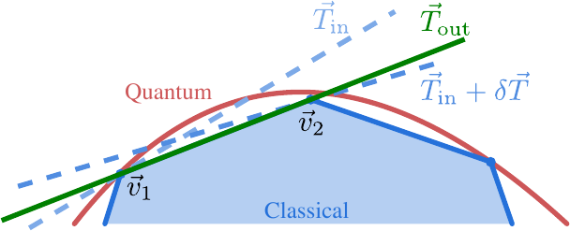
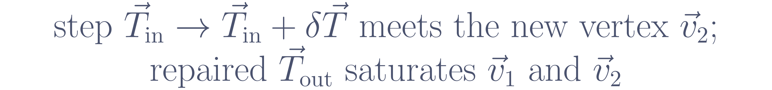
The update step
I · Gradient method

Slide 19
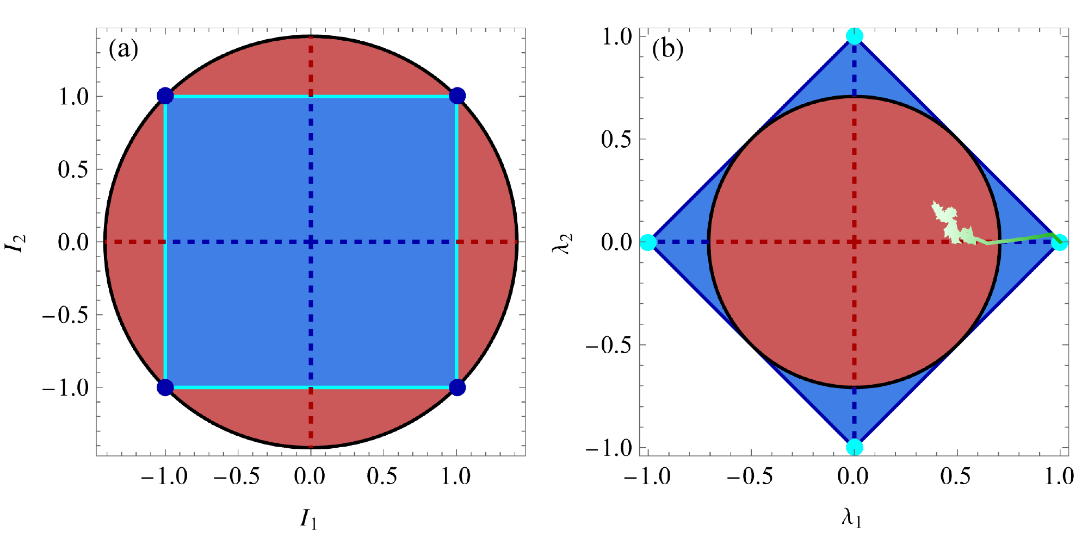
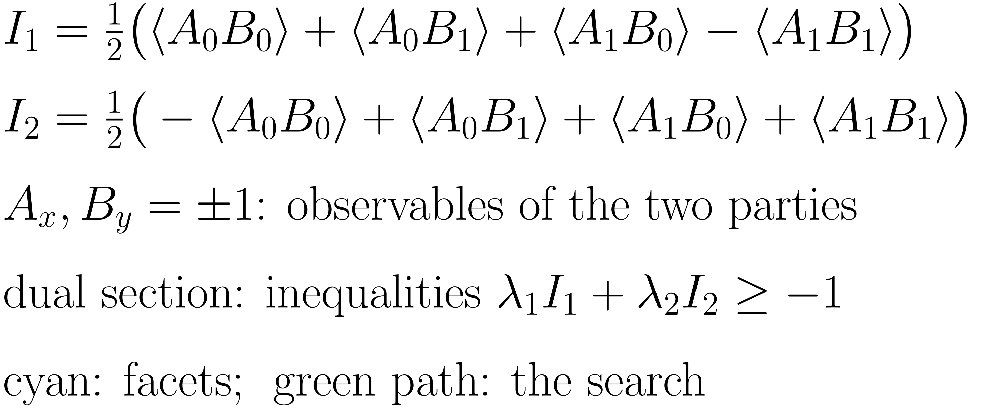
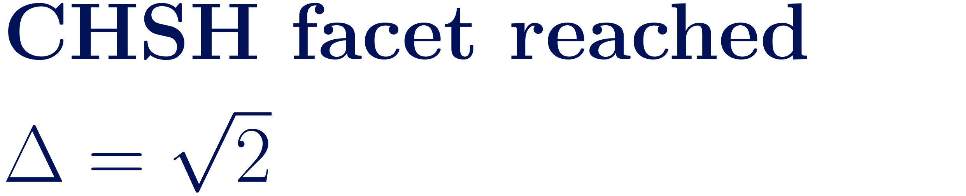
Benchmark: the search recovers CHSH
I · Gradient method

Slide 20
Part II
Permutation-invariant Bell inequalities
facets at finite size · optimized inequalities in the thermodynamic limit
J.-F. Chen, M. Hu, J. Tura, arXiv:2607.08462

Slide 21
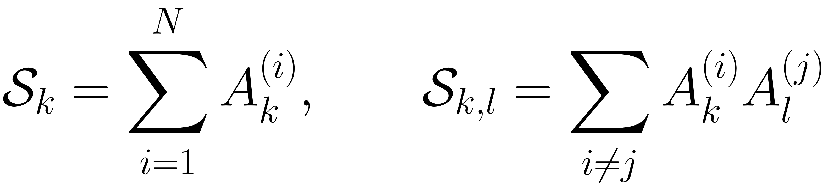
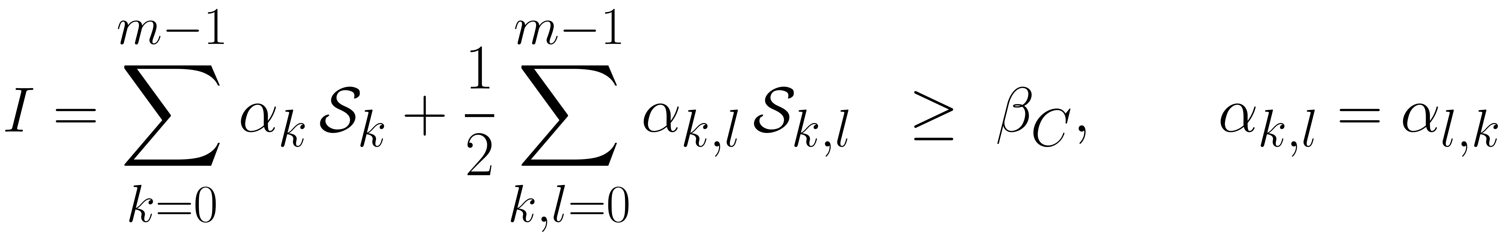
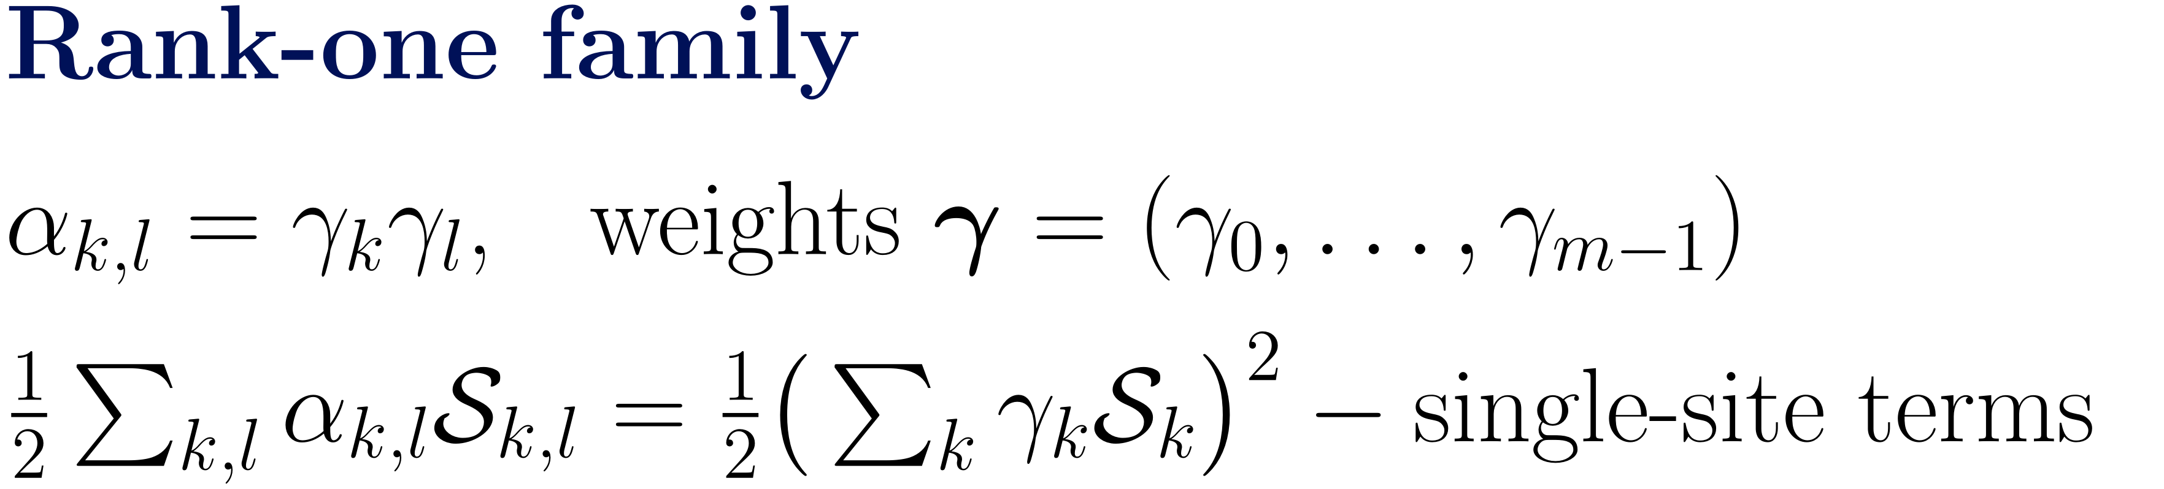
Collective one- and two-body correlators
II · PI inequalities
permutation invariant: no party labels
collective spin moments: ensemble data
few coefficients for any number of parties

Slide 22
What permutation symmetry buys
II · PI inequalities

Slide 23


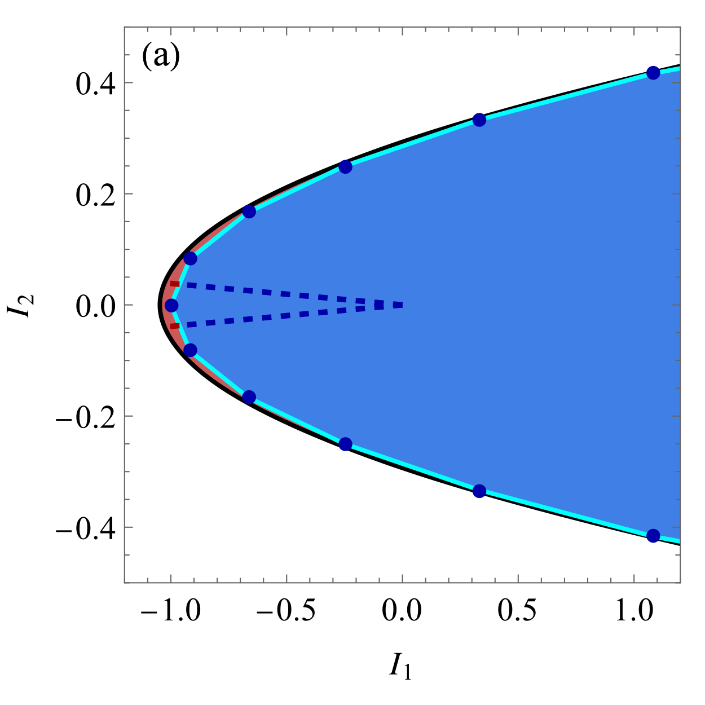
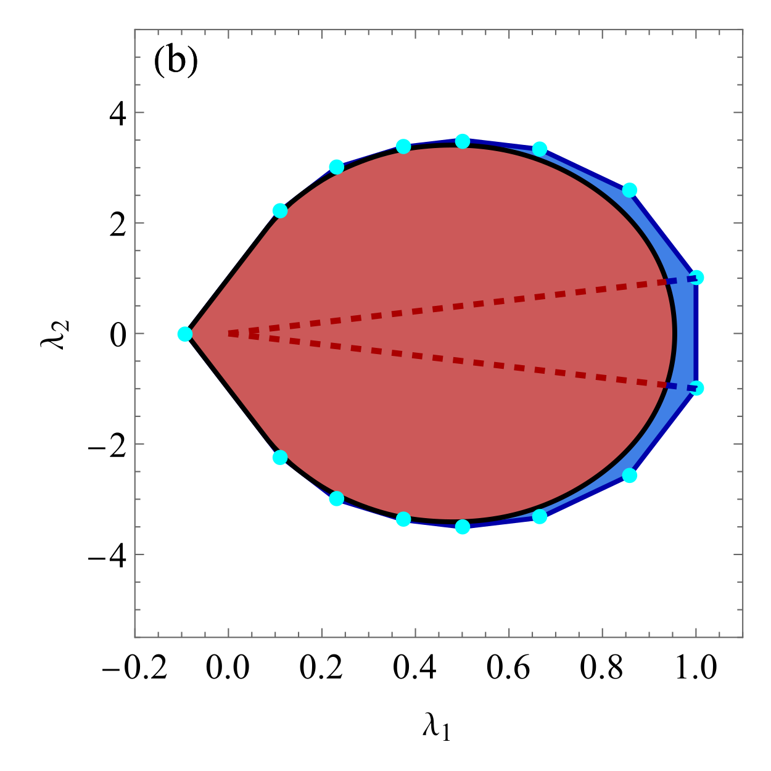
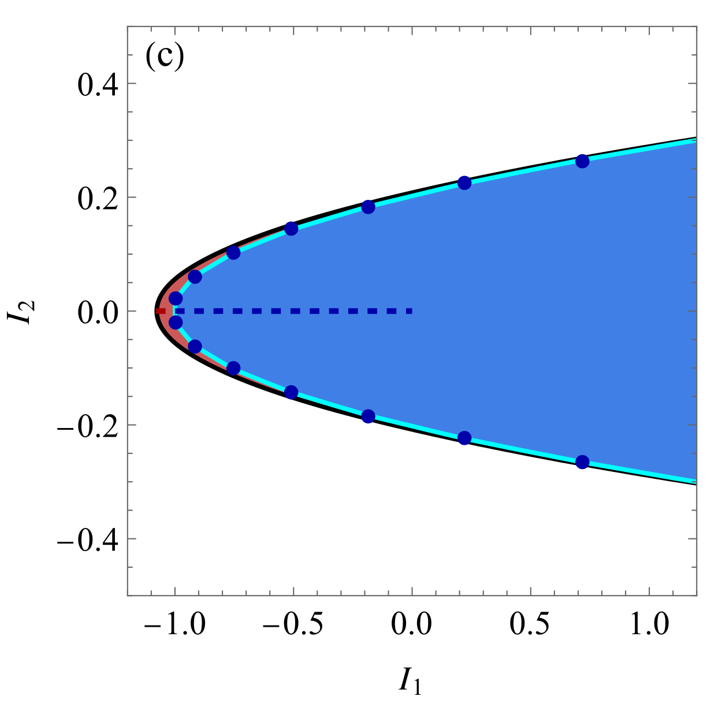
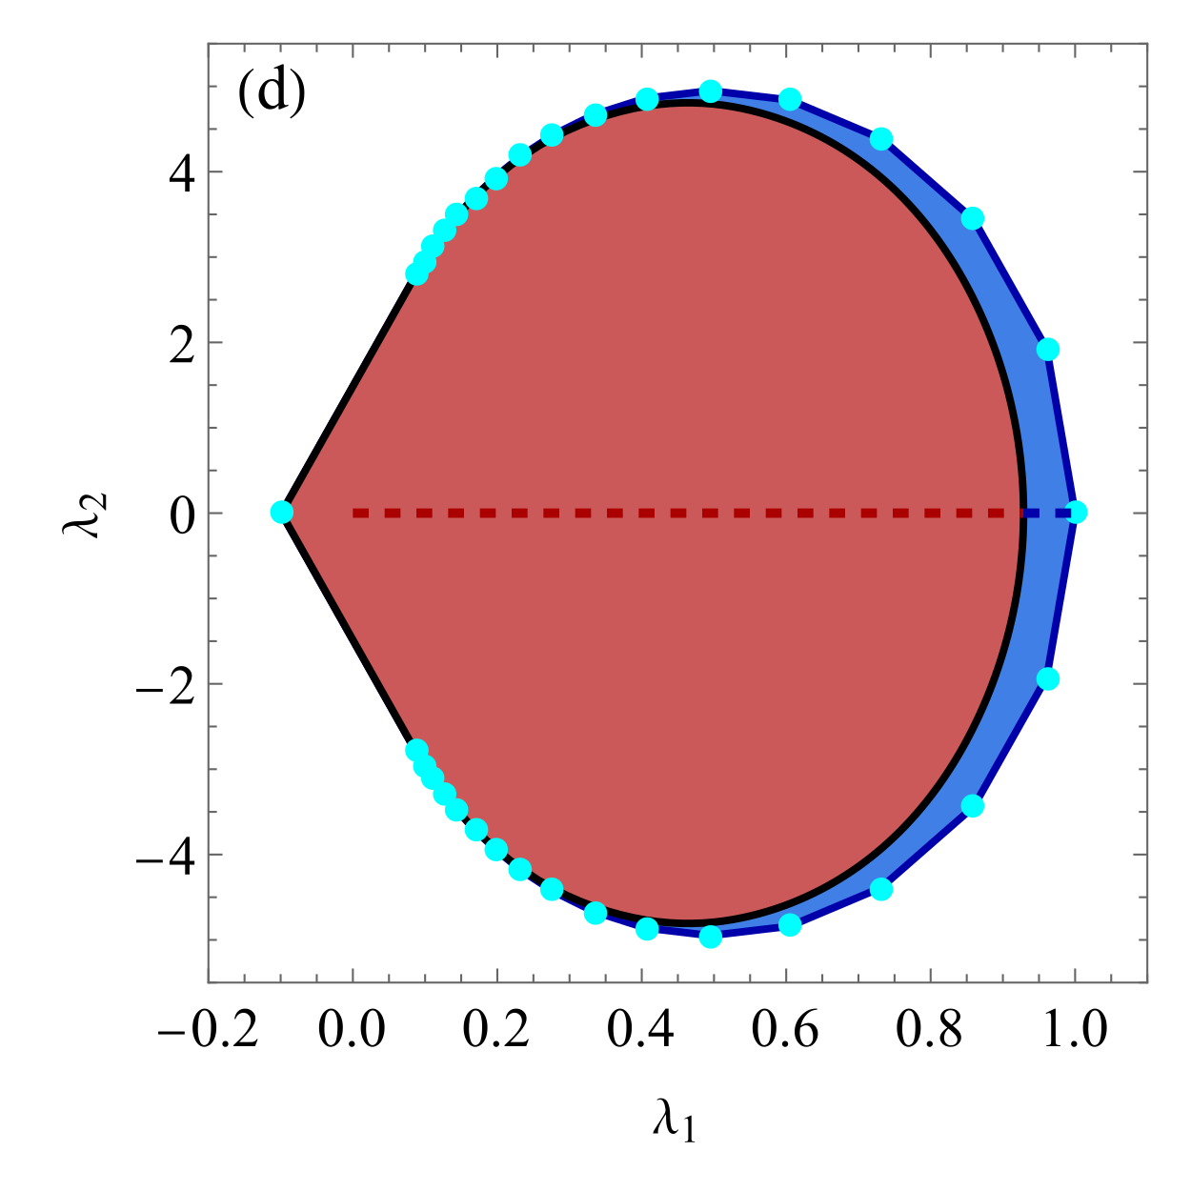
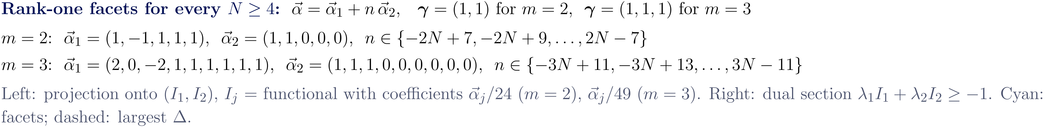
Families of facets
II · PI inequalities

Slide 24
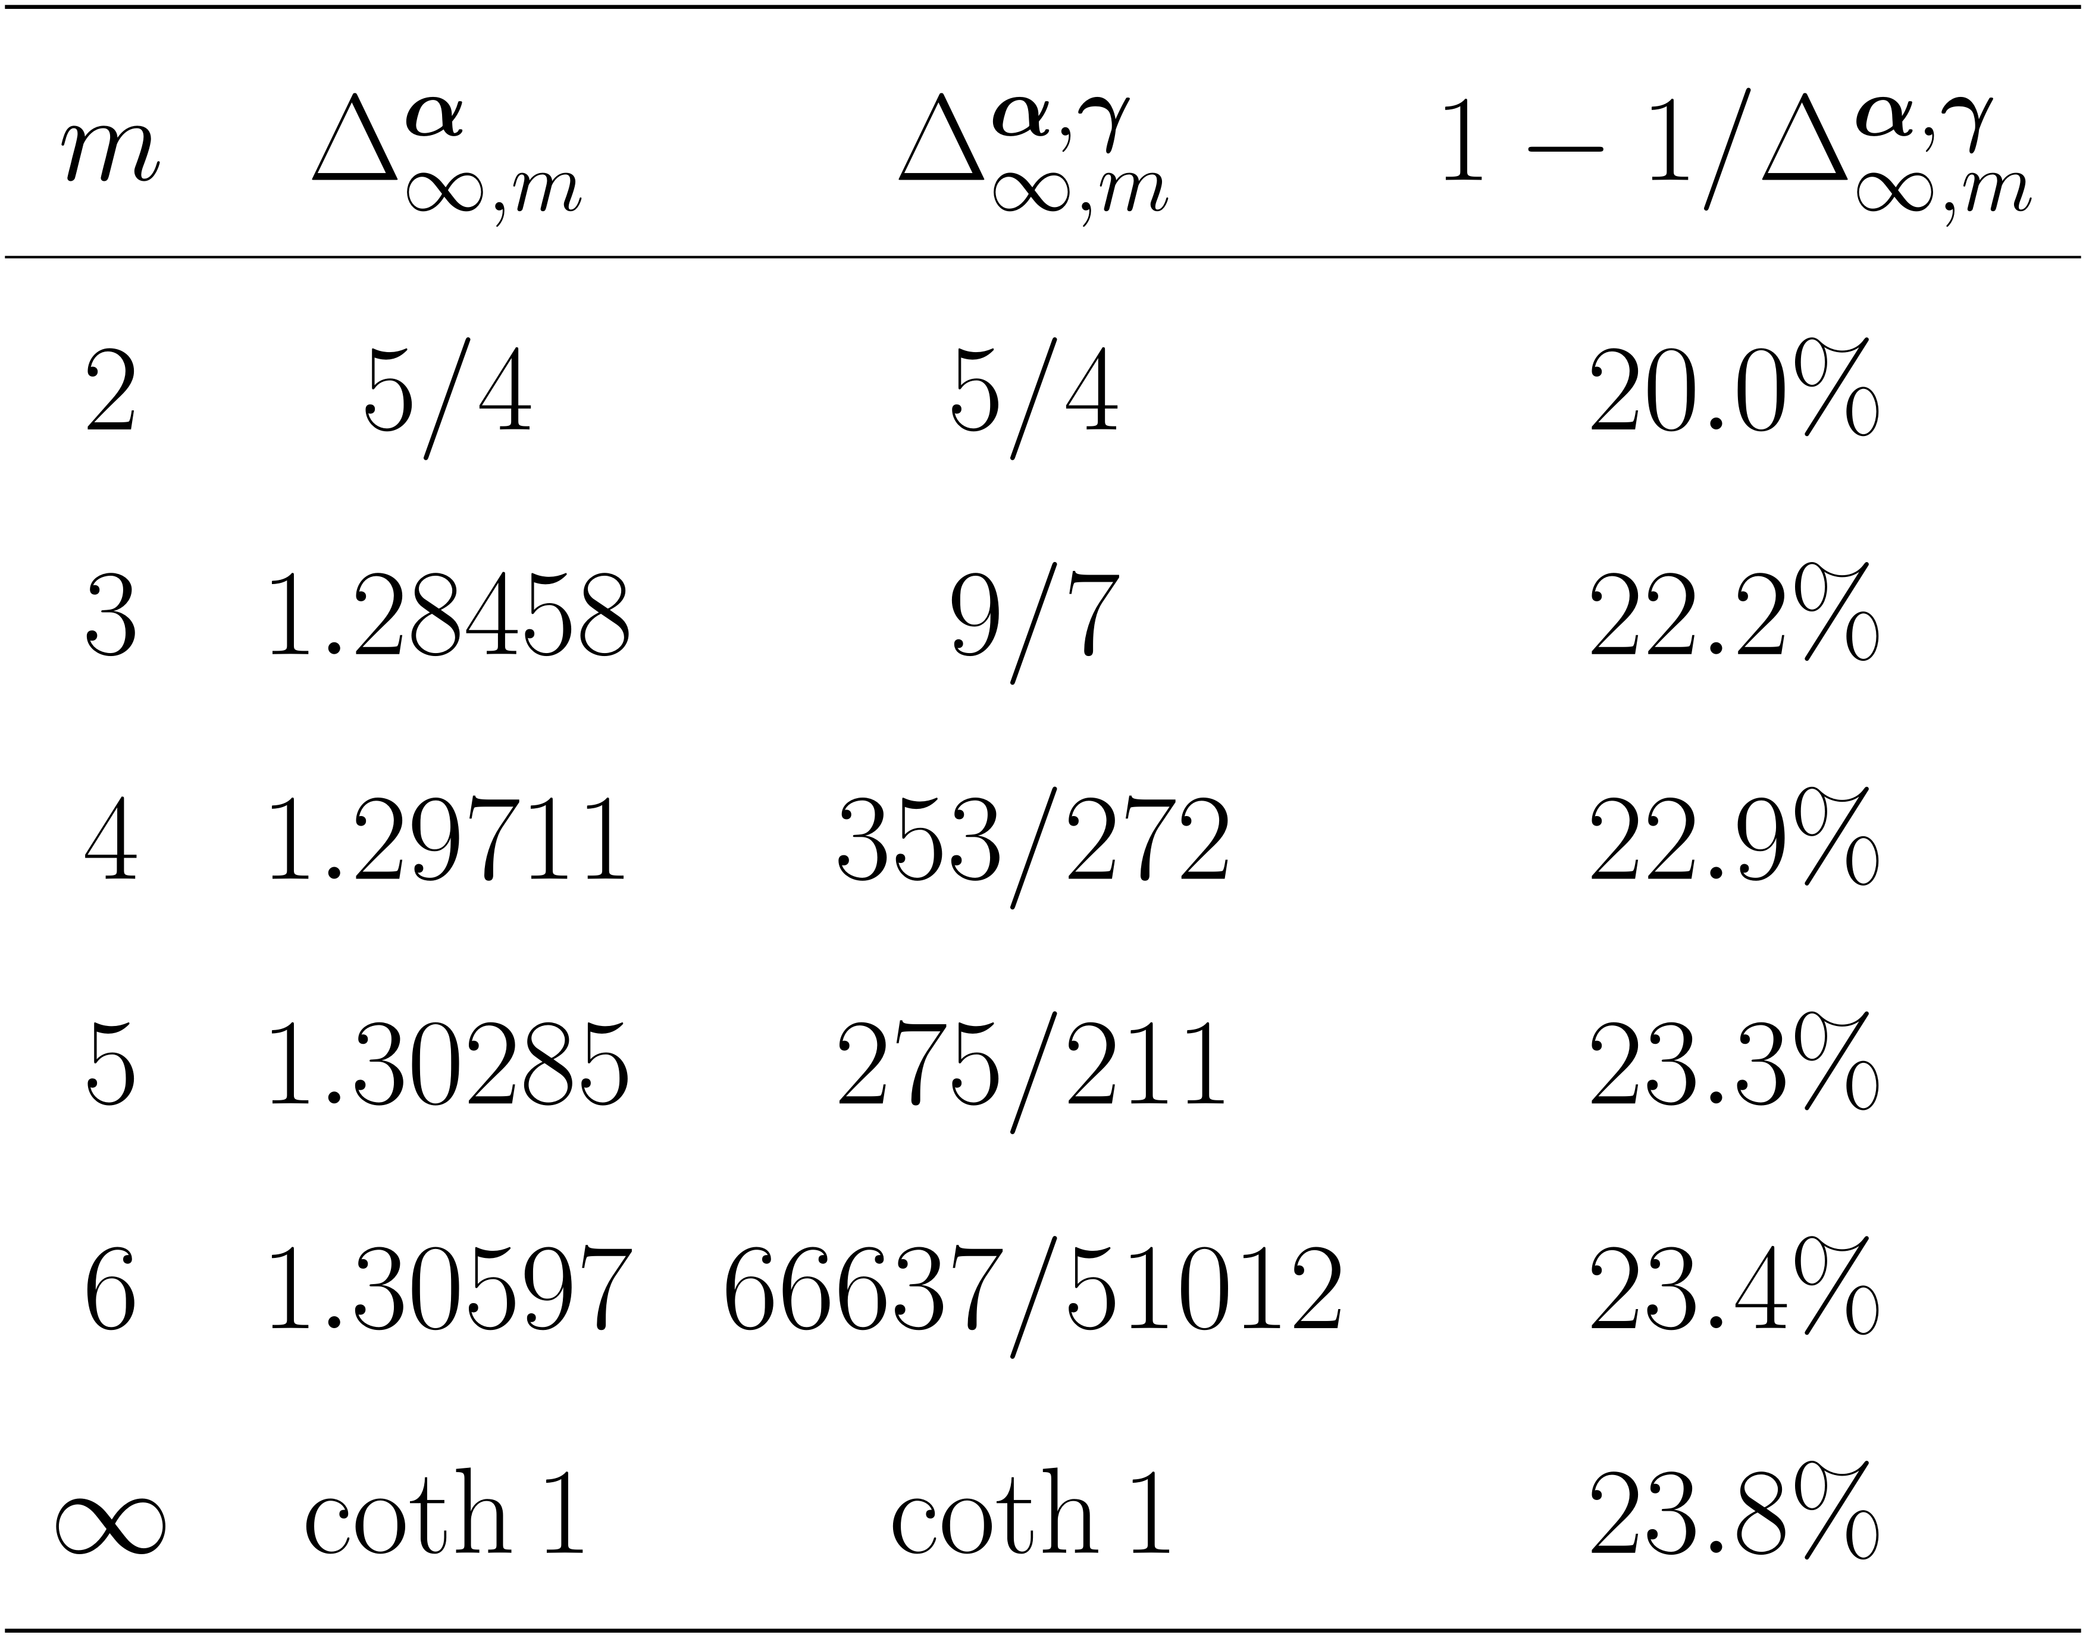
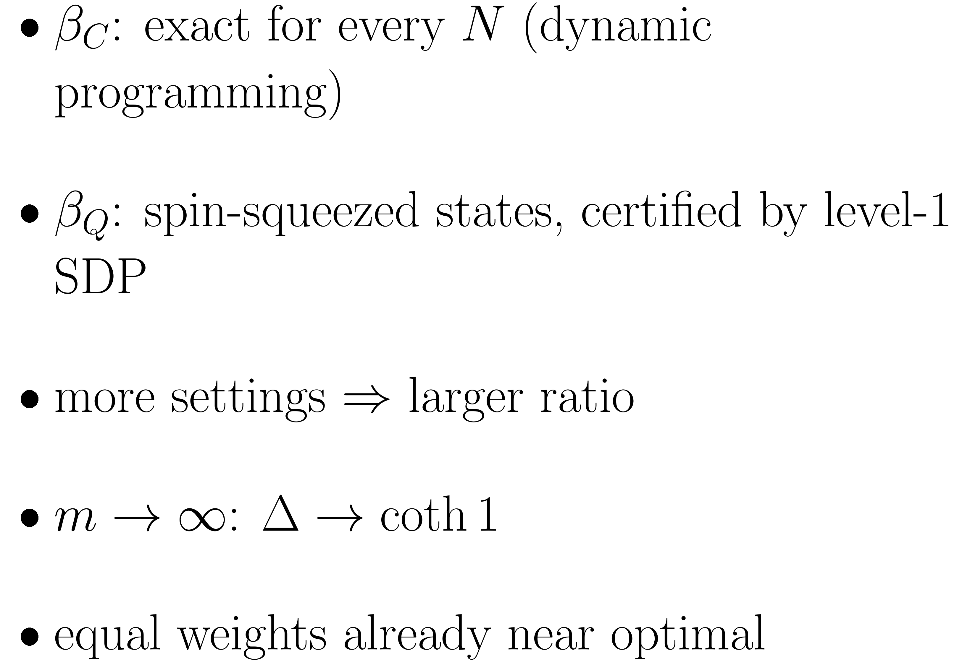
Thermodynamic limit: optimized ratios
II · PI inequalities

Slide 25
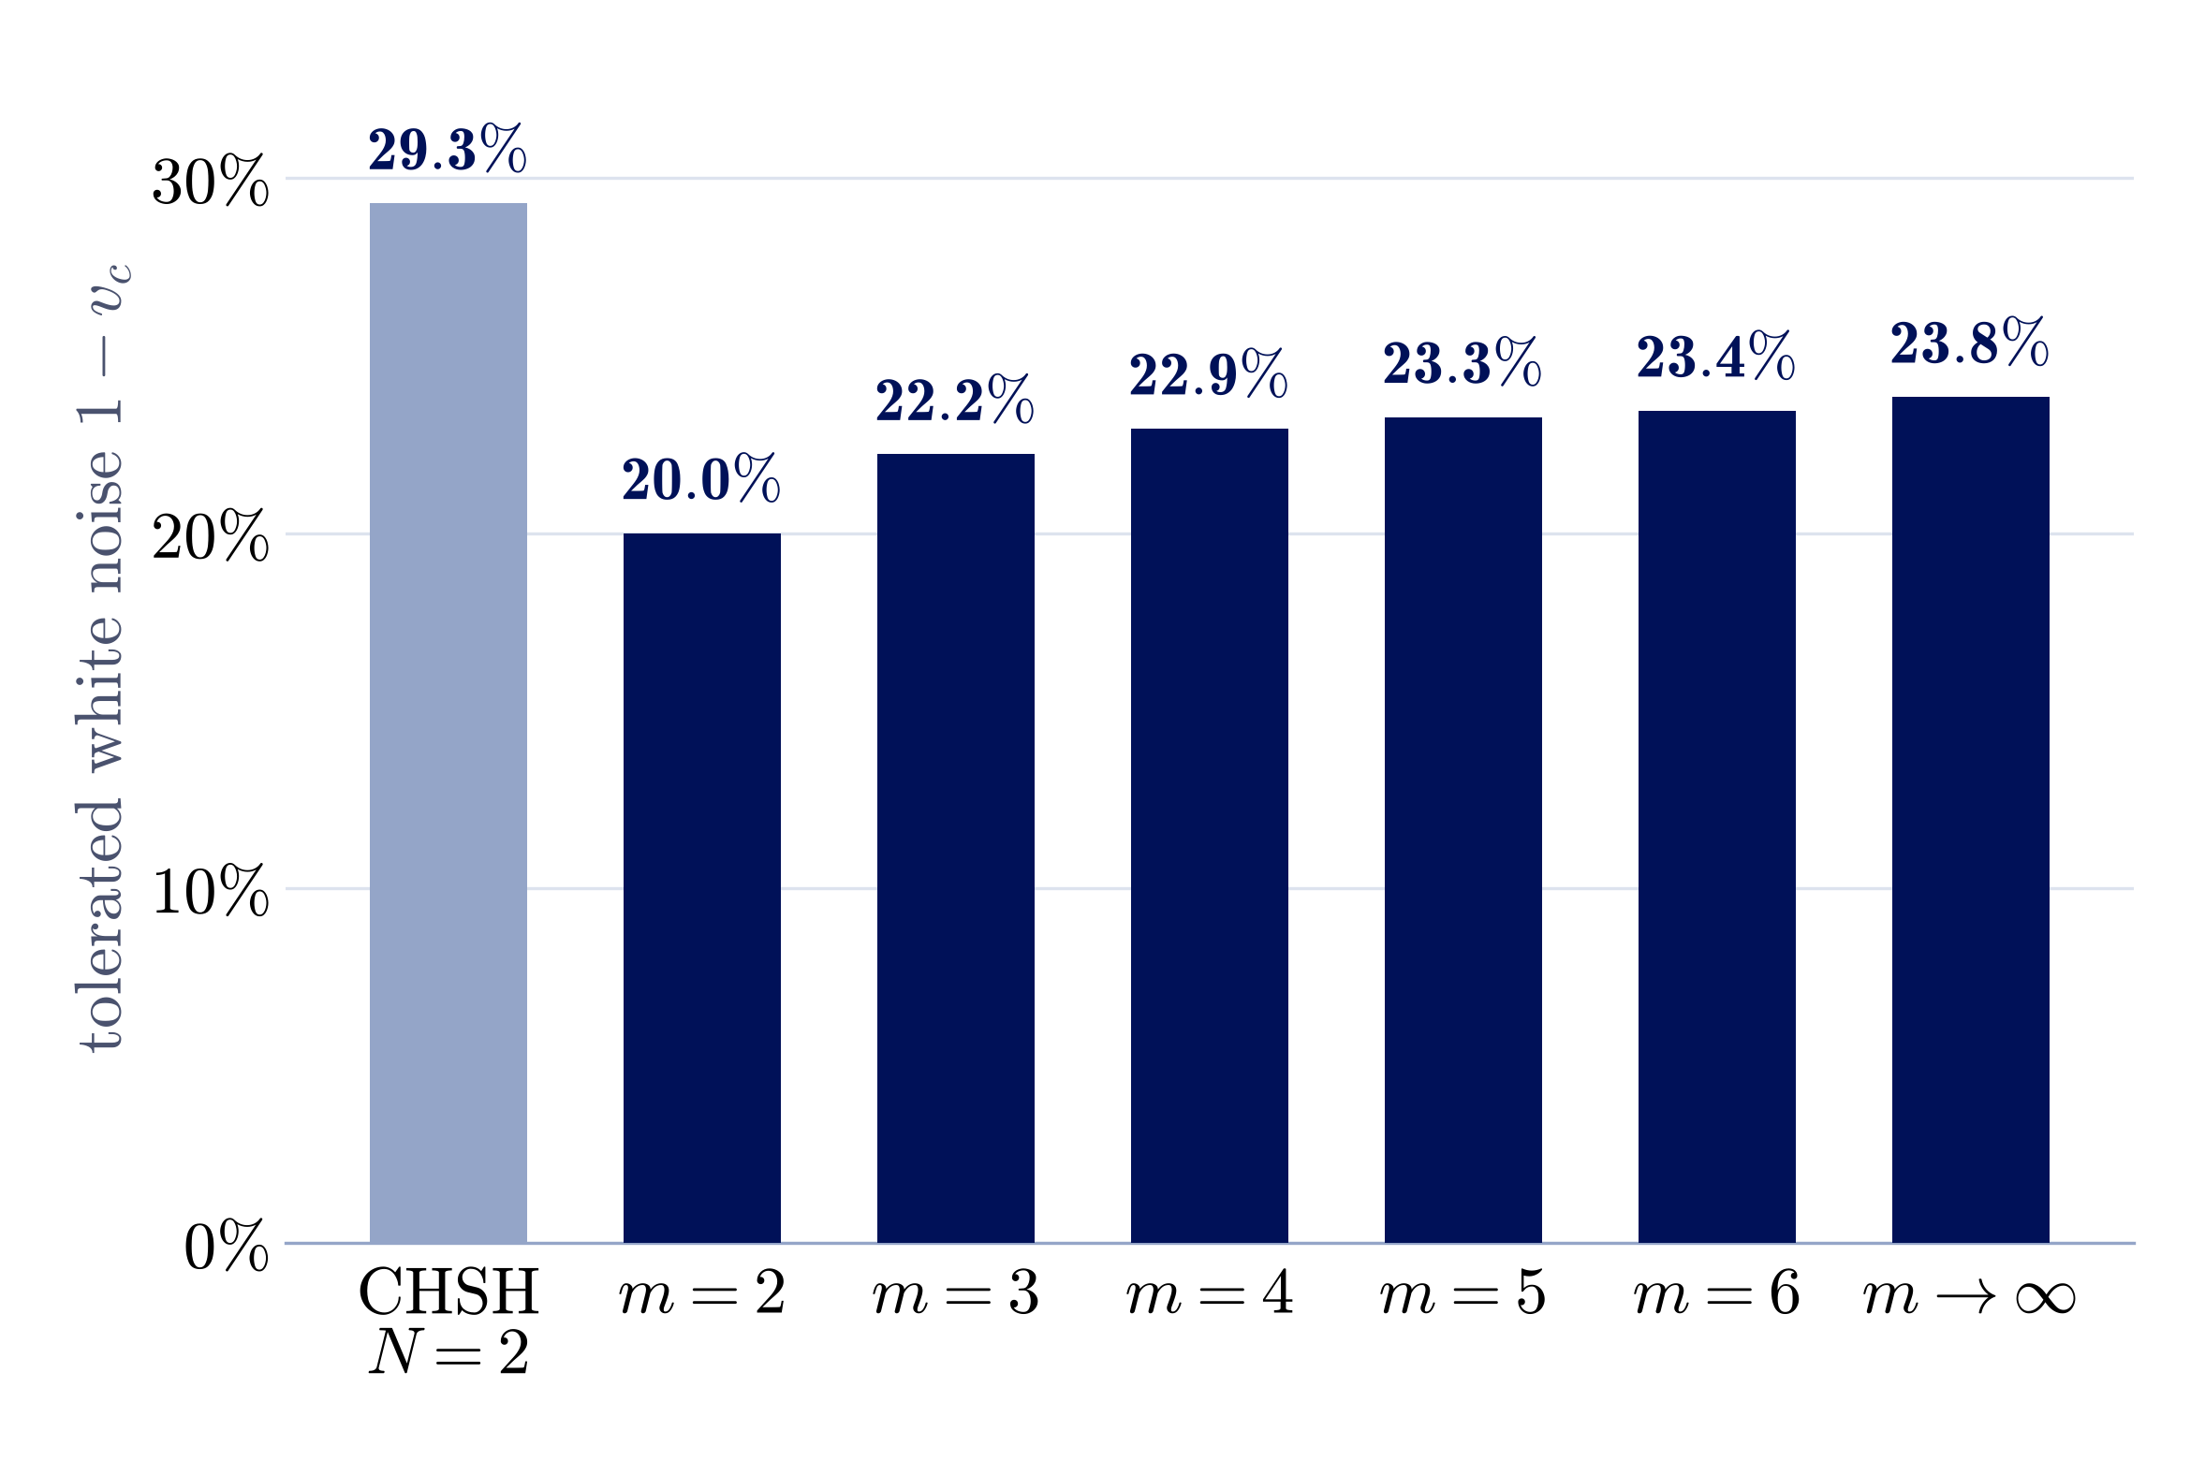
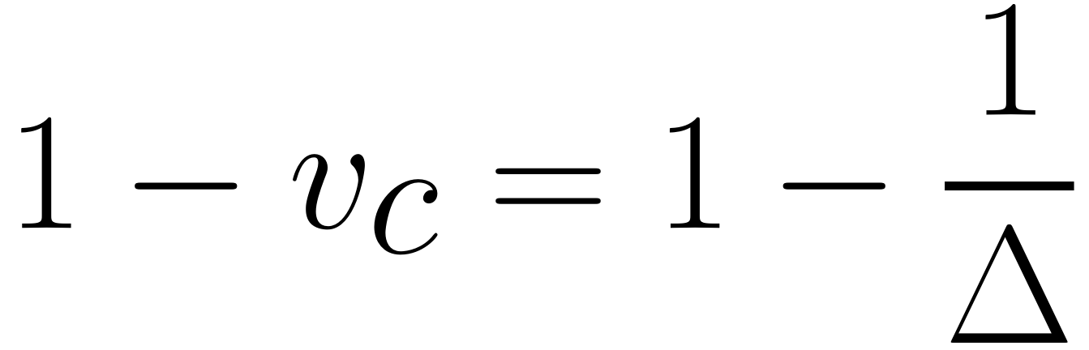

Noise tolerance in the thermodynamic limit
II · PI inequalities
Up to 23.8% with collective data.

Slide 26
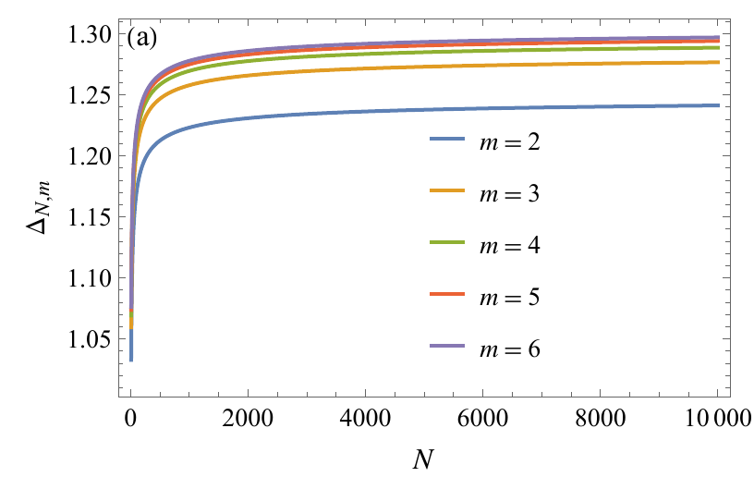
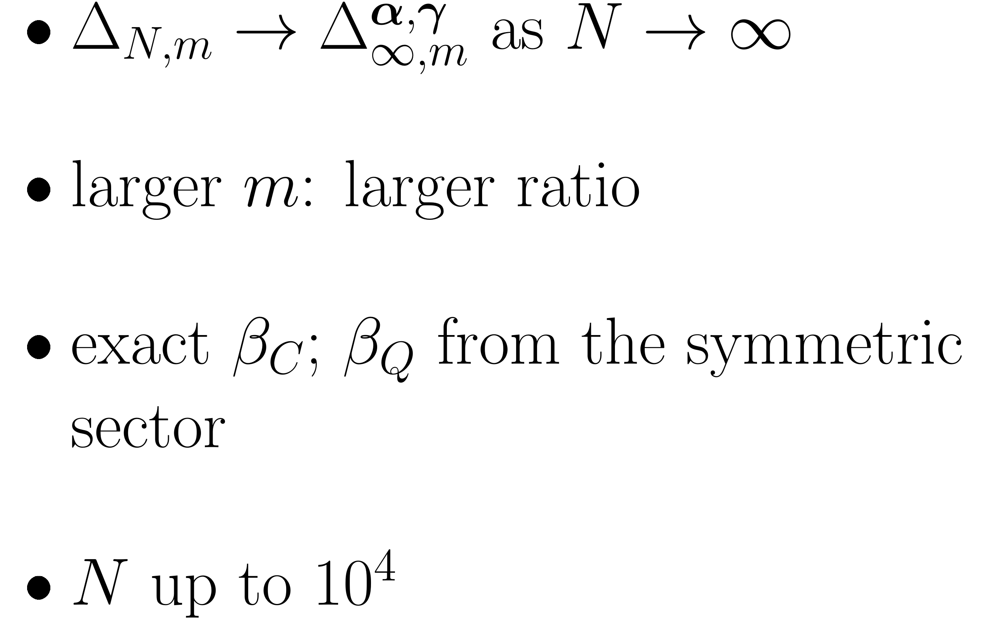
Finite-size ratios converge
II · PI inequalities

Slide 27
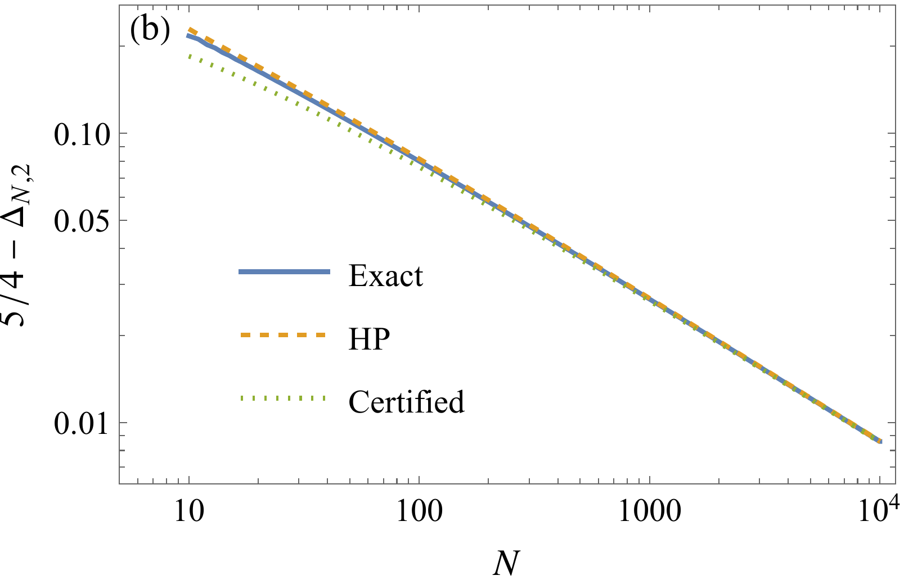
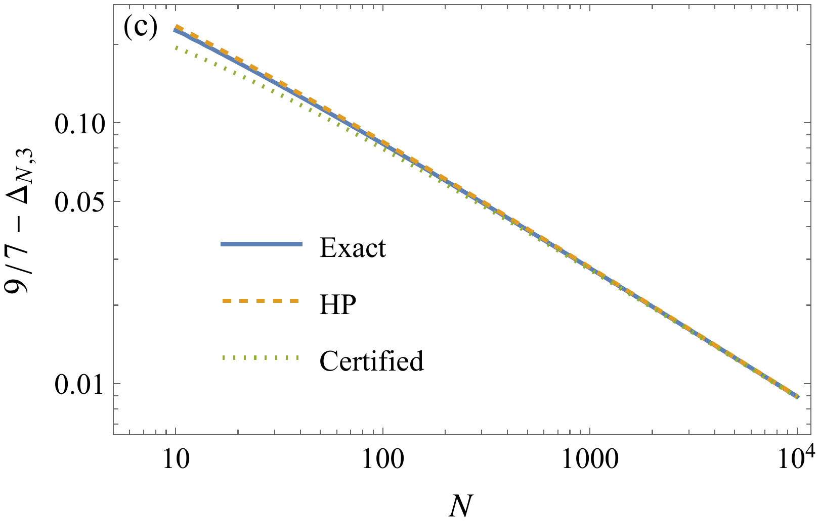
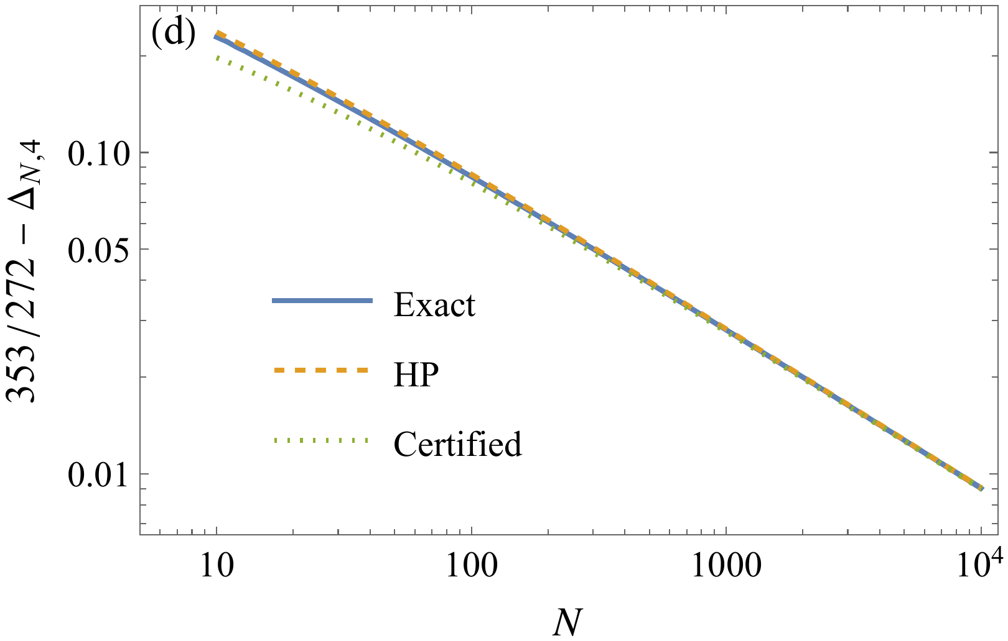
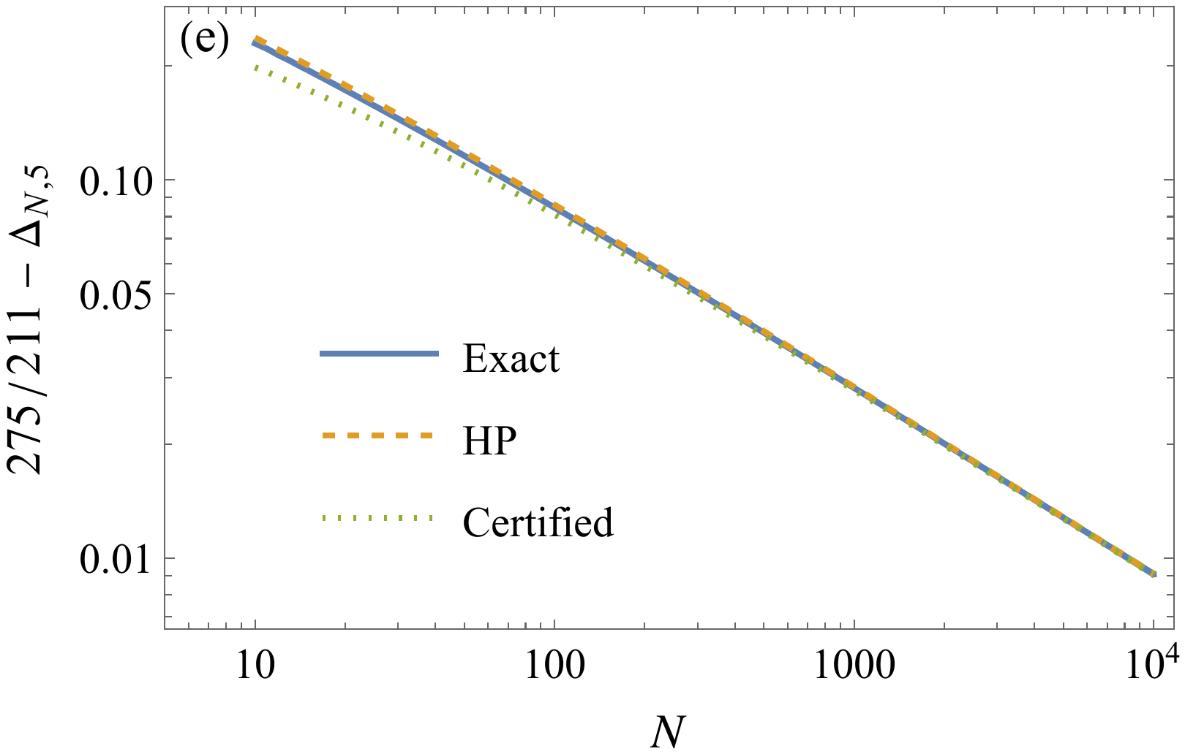
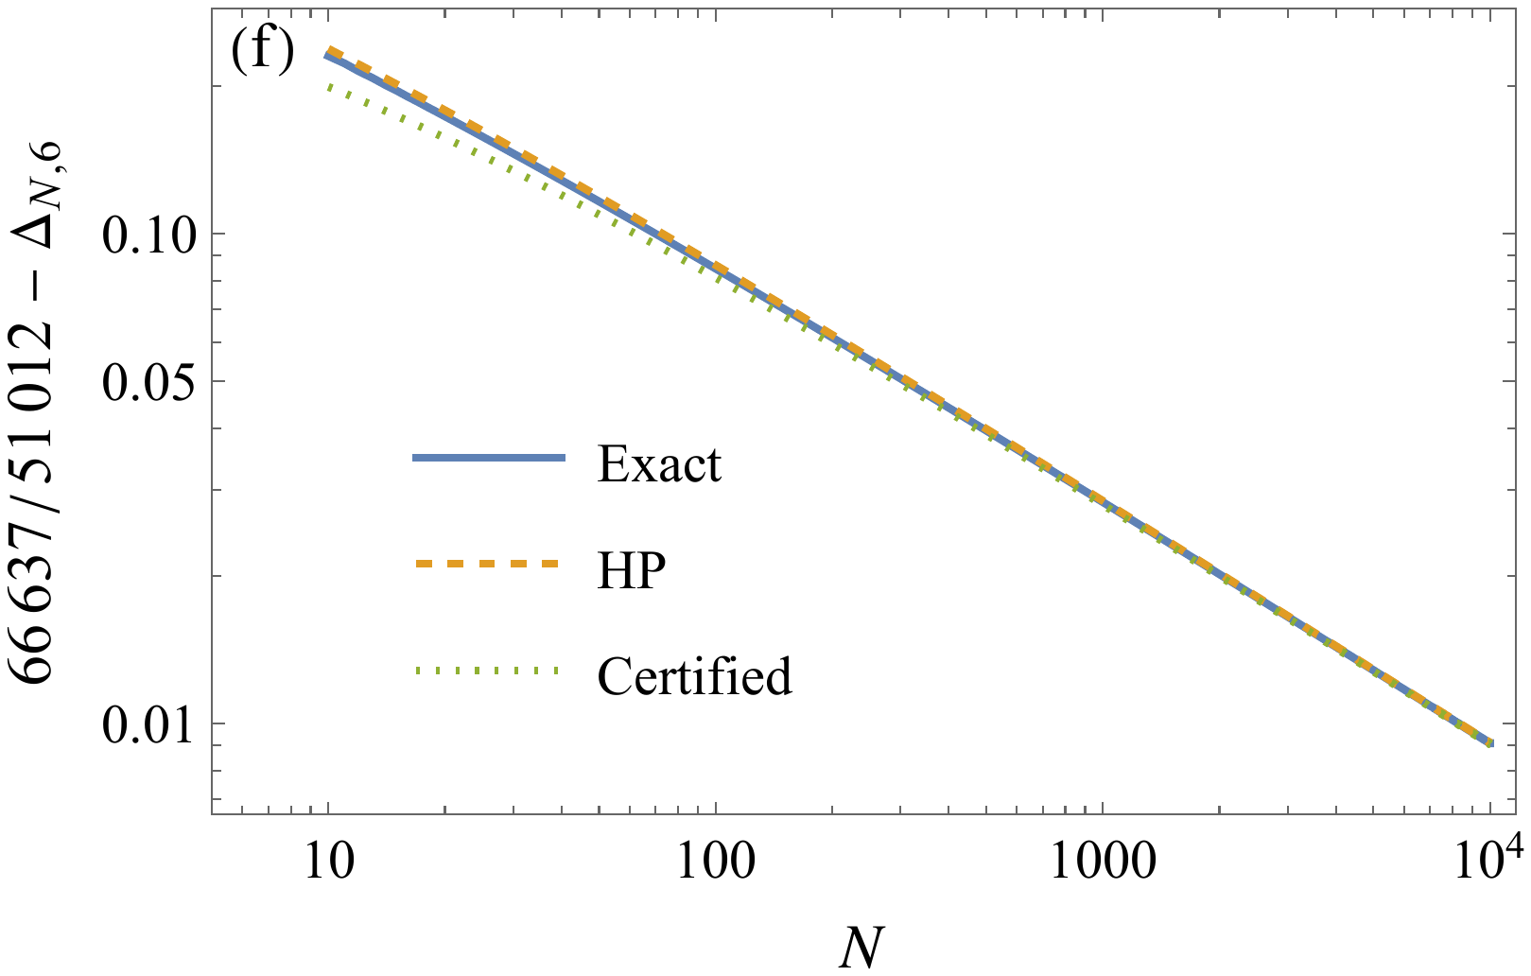
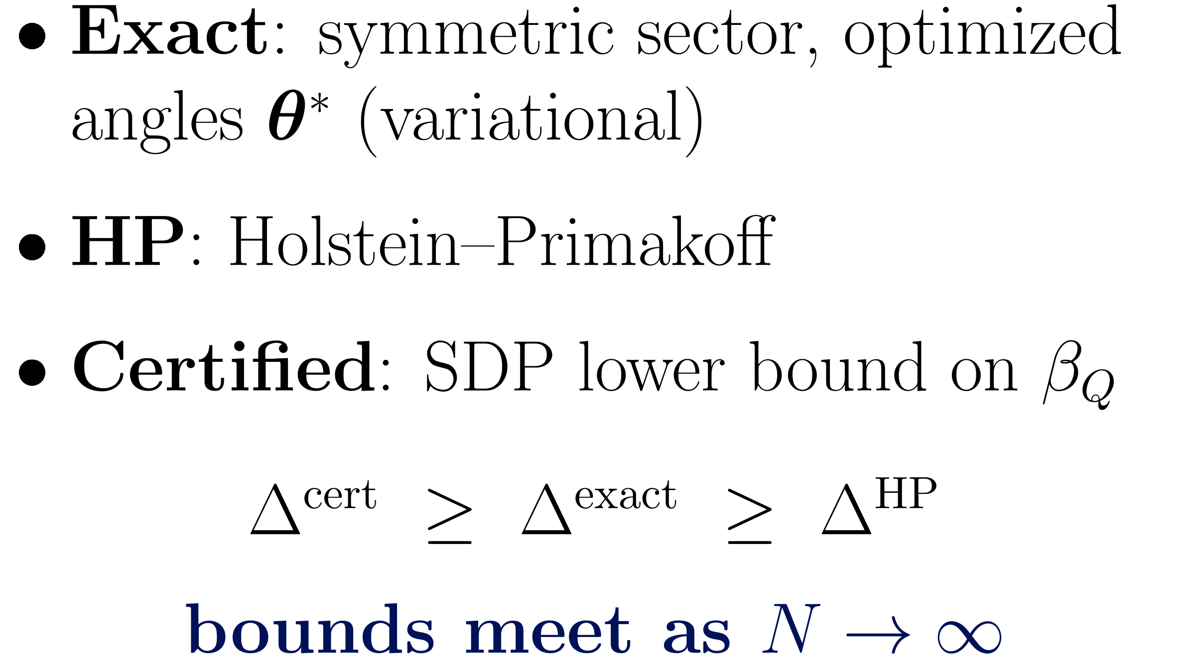
Variational values and SDP bounds
II · PI inequalities

Slide 28
Summary
I
Gradient optimization
optimize the coefficients for the robustness ratio
gradient: optimal quantum behavior; constraints: active classical vertices
local optima are facets: robust inequalities without enumeration
II
Permutation-invariant Bell inequalities
rank-one families of facets at finite size
thermodynamic limit: optimized analytically, certified by level-1 SDP
white-noise tolerance up to 23.8% from collective data

Slide 29
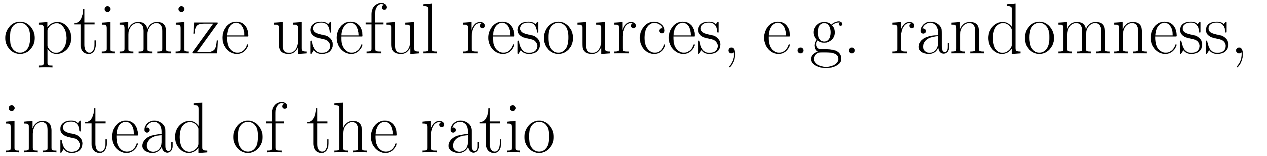
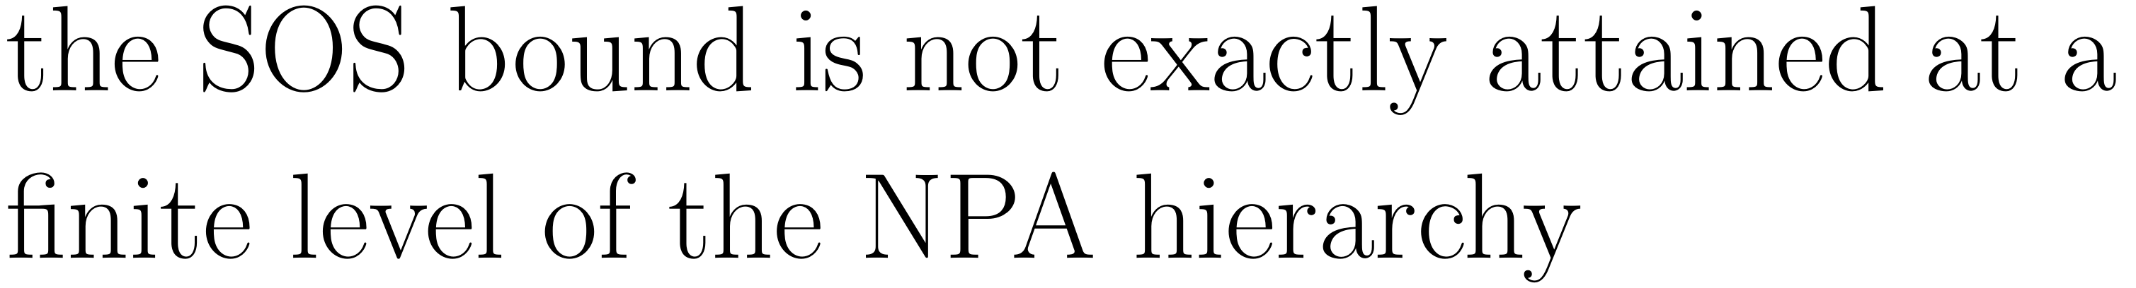
Outlook
1
Higher-body correlators
2
More outcomes
3
Other figures of merit
4
(Approximate) self-testing

Slide 30

Part I: arXiv:2511.07523 · Part II: arXiv:2607.08462

Slide 31
Appendix
Technical details
A gradient method · B thermodynamic limit · C level-1 SDP

Slide 32
Appendix A
Gradient method
formal theorem, proof idea, update rule, algorithm, finite-size results

Slide 33
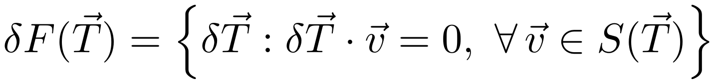
Theorem 1: formal statement
Appendix A · Gradient method
A nondegenerate local maximum
of the quantum-to-classical ratio
implies tightness of the Bell inequality.
Allowed directions keep every active classical vertex saturated.
Nondegenerate means the ratio is not locally flat
along any nonzero allowed direction.
With restricted coefficients, tightness refers to the projected local polytope

Slide 34


Proof idea: concavity on a dual face
Appendix A · Gradient method
Move along a direction preserving the active classical constraints.
The minimum of linear Bell scores is concave in the coefficients.
Without a flat direction, the coefficient vector must define a facet.

Slide 35



Update rule: projected quantum gradient
Appendix A · Gradient method
Rows of the active-vertex matrix encode the classical contacts.
Their Bell scores stay fixed.
At a differentiable inner optimum, quantum correlations give the derivative.

Slide 36

Adding a new classical contact
Appendix A · Gradient method
Add the new minimizing vertex to the active set.

Slide 37

The algorithm, step by step
Appendix A · Gradient method
Compute the classical minimum, normalize, and collect active vertices.
Optimize the quantum state and measurement settings.
Take the projected step. Add new minimizers and reproject.
Recheck classical validity. Reduce the step and retry if needed.
Reoptimize the quantum strategy at the accepted coefficients.
Retry if
Stop at a facet

Slide 38


Optimized facets at finite size
Appendix A · Gradient method

Slide 39


Four parties: two vs three settings
Appendix A · Gradient method
Two measurement settings
Three measurement settings
A third setting raises the tolerated white noise from 10.2% to 13.8%.
Achieved values within identical measurements and the symmetric-qubit ansatz

Slide 40



Facet families: coefficients
Appendix A · Gradient method
The two central choices
maximize the ratio
within this family.
Twelve parties, two settings

Slide 41
Appendix B
Thermodynamic limit
rank-one family, classical recursion, spin squeezing, coefficient optimization

Slide 42



Rank-one family: two-body part is a square
Appendix B · Thermodynamic limit
Choose rank-one two-body coefficients:
classical, in occupation numbers
quantum, identical measurements in the symmetric sector
Classical: only one accumulated sum enters the square → dynamic programming.
Quantum: one squared spin component → spin squeezing.

Slide 43




Classical side: dynamic programming
Appendix B · Thermodynamic limit
Keep the lowest score at each particle count and accumulated weighted sum.
Unreachable accumulated sums have infinite cost. The finite-system bound is exact.

Slide 44




Collective-spin Bell operator (paired)
Appendix B · Thermodynamic limit
Identical coplanar measurements and a symmetric-spin ansatz. Couplings shown for even settings.

Slide 45



Quantum side: spin squeezing
Appendix B · Thermodynamic limit

Slide 46

Leading order: a variational problem
Appendix B · Thermodynamic limit
Replace the many-body search by a variational problem
in the measurement projections.
The spin-squeezed construction determines the leading extensive term.

Slide 47


Optimizing the coefficients
Appendix B · Thermodynamic limit
Tie a nested sequence of classical strategies at the same bound.
Interior quantum stationary points share one fluctuation parameter.
Shown for an even number of settings. Positive weights make the construction attainable.

Slide 48




Example: two settings
Appendix B · Thermodynamic limit
A single scalar determines the optimum.
20% global white-noise threshold asymptotically. Strict violation requires less noise.

Slide 49


Three settings: optimized weights
Appendix B · Thermodynamic limit
Exact classical bound
Leading variational quantum value
Optimized positive weights give a small gain over equal weights.

Slide 50


Oscillator approximation
Appendix B · Thermodynamic limit
Holstein–Primakoff energy around the transverse spin direction

Slide 51


Finite-size quantum checks
Appendix B · Thermodynamic limit
Diagonalization, HP and the
moment bound approach
the same leading limit.
The moment bound fixes the
optimized angles and
total-spin sector.
The displayed ordering concerns the ansatz and plotted system sizes

Slide 52
Appendix C
Level-1 SDP
certified lower bounds on the quantum value

Slide 53

Bounds on the quantum value
Appendix C · Level-1 SDP
Achievable value
Certified bound
An explicit state and measurement strategy demonstrates a Bell violation.
A level-1 SOS bound limits every quantum strategy.

Slide 54



Level-1 SDP: a sum-of-squares ansatz
Appendix C · Level-1 SDP
A positive shifted Bell operator gives a quantum lower bound.

Slide 55

Level-1 SDP: the program
Appendix C · Level-1 SDP
Collect the coefficients of the squares in two Gram matrices:

